Slide 1
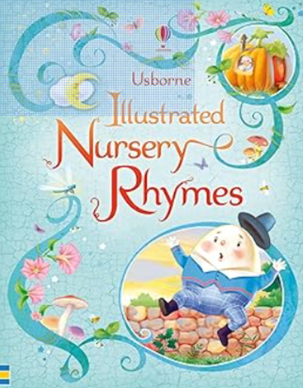

F1: Reading: Include Basic reading skills: Introduce the FANTASTICS
Week 1/2
Book Handling (Fiction and Non Fiction)
Focus: Routines
Front cover (How to choose a book) / other parts of a book – Revisit weekly
Using favourite books)…look at parts/features of books
Text type/routines
Week 3
Nursery Rhymes
Focus: Joining in and sharing favourite Nursery rhymes
Other Texts: How to be a Friend
Week 4
Each Peach Pear Plum Fiction Introduction of the story.
Focus: Children’s opinions
My favourite part of the story is… because…
Non-fiction text: Fill a Bucket
Week 5
Each Peach Pear Plum
Focus: Children talk about what they notice/
Jumping Into the Picture (introduction to the FANTASTICS): Using Adjectives
Other texts: Nursery Rhyme Texts
Week 6/7
Each Peach Pear Plum
Word Catching: Positive and Negative words
Other texts:
Word Catcher
Week 8
Each Peach Pear Plum
Helicopter Stories – making up our own I spy stories.
Other Texts:
My Friend Bear
What will be learning about over the coming weeks?

Slide 2
Drawing Club
Week 3
Humpty Dumpty
Character:
Humpty
Vocabulary:
Perched: To sit/rest on the edge.
Plummet: To fall
Fragile: Easily broken
Shattered : Smashed into tiny pieces
Codes:
Egg/1
Week 5
Each Peach Pear Plum
Character:
Mother Hubbard
Vocabulary:
Ancient: Very Old
Canine- Animal in the dog family
Famished- Really hungry
Zero- Another word for nothing/none.
Codes:
Character /0
Week 4
Each Peach Pear Plum
Character:
Tom Thumb
Vocabulary: Miniature - Very small
Whispered- To speak quietly
Gobbled- To eat quickly
Escaped- To get free of something
Codes:
Character/2
Week 6
Each Peach Pear Plum
Character:
Cinderella
Vocabulary:
Chores- Jobs around the home
Vehicle: A machine used to carry people.
Royal: Belonging to the king, Queen or their family
Dream: A story your mind makes up.
Codes:
Character/shape
Week 8
Each Peach Pear Plum
Character: Bo Peep
Vocabulary:
Wagging: Shaking back and forth
mislaid: Lost
Perplexed: Puzzled
Searched: Looked for
Codes:
Character/4
Week 7
Each Peach Pear Plum
Character:
The 3 Bears
Vocabulary:
Snooze- A short sleep Crept: Moved slowly and quietly
Ecstatic: Really happy/excited
Apologise: To say sorry
Codes:
Bear /3
What will be learning about over the coming weeks?

Slide 3


F1: Understanding of the World: Peoples and Communities & Prime Areas
Week 1/2
Introduction to Lawns Park School
Rules/Routines/Expectations/
People/Places
Week 3
This is me.
I like to…
play…
Eat…
Watch…
Read…etc
Week 4
Friendships
What is a friend?
How can we be good friends?
Caring Caterpillars.
Week 5
Home & Family
I live….
This is my family…
Week 6
Celebrating differences
How do we differ?
Filling buckets
Week 7/8
Respect
What is it?
How can I show it?
What will be learning about over the coming weeks?

Slide 4
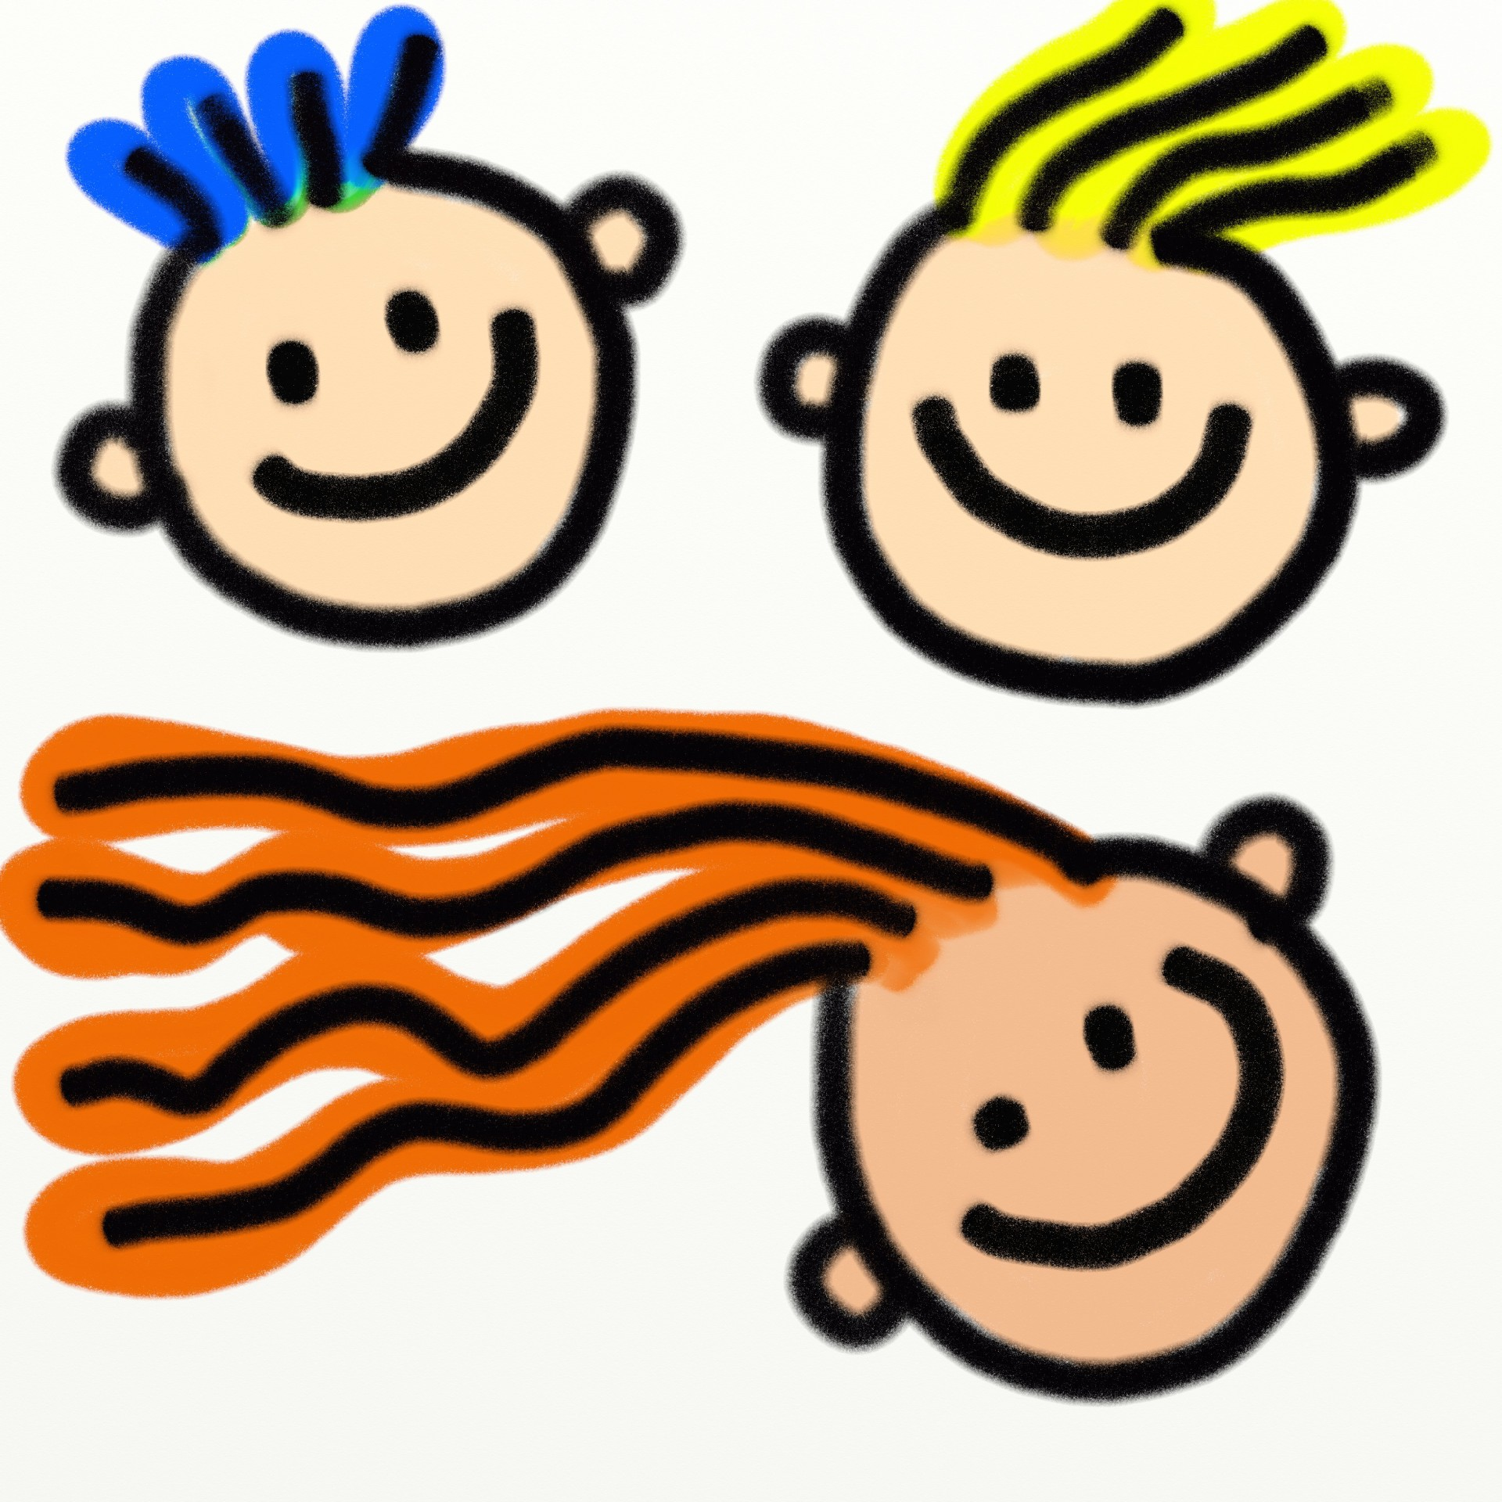
F1: Mark Making & Physical Development
Week 1/2
Movement
And marks
Squiggle whilst you wiggle
Dough Disco
Week 3
Lines
Drawing straight lines
Vertical and
Horizontal
Pencil grip:
Finger Gym activities
Week 4
Circles
Making circular movements/forming anti-clockwise circles
(Look at Kandinsky)
Week 5
Shapes
Using lines to create shapes
Pencil Control
Week 6
Mark Making Tools
Using different mark making tools to create different effects
Week 7/8
Faces
Drawing Portraits
Looking closely at our faces to help us draw self portrait
What will be learning about over the coming weeks?

Slide 5
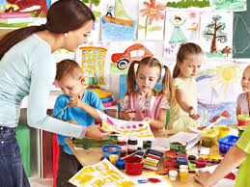
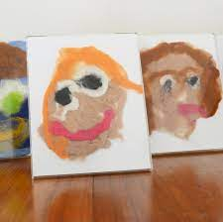
EAD: Weekly: Exploring & Using Media/Materials : Dancing/singing and exploring with colour mixing
Being Imaginative: Role play and small world areas/ becoming characters (using puppets etc)
Week 1/2
Movement and Dance
Nursery Rhymes
Brain Breaks
Week 3
Drawing
Self portraits for displays.
Using pencil/charcoal to draw lines and create shapes.
Week 4
Fixing and Joining
Caring Caterpillars
Working Collaboratively to create a class caring caterpillar – adding comments of how we can show we care.
.
Week 5
Building and Constructing – Let’s make our homes.
Skills:
Material Selection
Combining materials
Fixing and joining
Week 6
Skill: Colour Mixing
Using primary colours to create secondary colours.
Noticing change
Artist Study: Kandinsky
Concentric Circles
Week 7/8
Painting Portraits
Artists Study Picasso
What will be learning about over the coming weeks?

Slide 6

F1: Mathematics
Week 1/2 Getting to Know You
Routines and songs
Vocabulary: Number, Numeral, Count, Amount etc
Registration: Introduction to 10 Frames
Week 3
Getting to Know You
Counting 1-1 Saying Numbers in order /saying one number for one thing
Story: Hooray for Fish/1 to 10 and Back Agaain
Week 4
Just Like Me
Matching/sorting
Sorting objects by colour, size and shape
Story: Noah’s Ark
Week 5
Just Like Me
Matching
Identifying similarities & differences
Matching Pairs Visual Discrimination: Which doesn’t belong?
Subitising
Story: The Button Box
Week 6
Just Like Me!
Comparing quantities/size
Vocabulary: More, fewer, less, equal. smaller, bigger shorter, longer
Story: The Enormous Turnip / Where’s my Teddy
Week 7/8
Just Like Me!
Pattern: Pattern hunts in the environment/ story
Vocabulary:
Stripy, spotty, zig-zags etc Rangoli patterns
Story: Pattern Fish
What will be learning about over the coming weeks?

Slide 7



F1: Phonics
Week 1/2
Environmental Sounds
What is listening?
Sound Hunts
Body percussion & Rhythm
Exploring instruments
Rhyming Songs/stories
Week 3
Voice Sounds
Find the bear
Sound Talk
Giving Directions
Environmental Sounds:
Describing sounds
Week 4
Body Percussion/ Voice Sounds
Everybody do this…
Performing Action songs
Rhythm & Rhyme
Stories and Songs
Week 5
Voice Sounds /Alliteration
Geraldine’s Walk/Shopping Bag games
Environmental Sounds
Sound Lotto
Rhyme & Body Percussion
Changing sounds Quiet/loud/soft/ gentle/fast/slow
Week 6
Instrumental Sounds:
Guess the Instrument
Make a Band
Sound Story
Rhyme
Rhyming strings, stories and songs
Week 7/8
Body Percussion/ Rhythm
Just Dance
Hear the beat
Rhyme
Your name is…
Rhyming stories
Alliteration
Silly Soup
What will be learning about over the coming weeks?

Slide 8
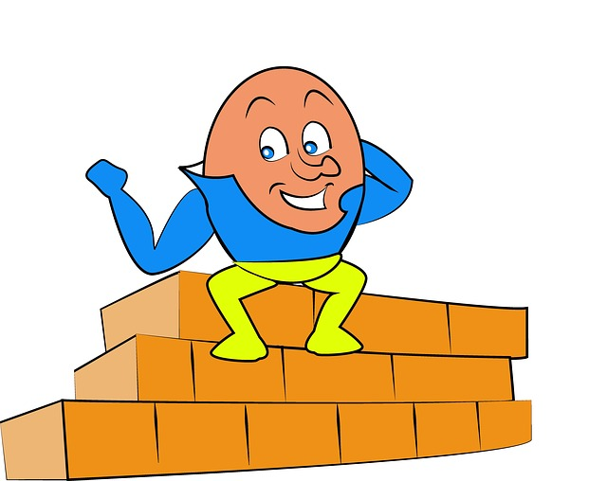
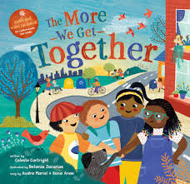
F1: Nursery Rhymes/Poetry
Week 1
Days of the Week
The More We Get Together
2 Little Dickie Birds
Number Songs
Week 2
Hickory Dickory Dock
The More We Get Together
Number Songs
Week 3
Humpty Dumpty
The More We Get Together
Dr Foster
Number Songs
Week 4
Miss Polly Had A Dolly
The More We Get Together
Number Songs
Week 5/6
Cobbler Cobbler
The More We Get Together
Week 7/8
Favourite Rhymes
The More We Get Together
What will be learning about over the coming weeks?

